Slide 1
Baton Rouge
Accident Data
Giancarlo Palumbo

Slide 2
Questions from the start
Is there any location in Baton Rouge that has the most amount of accidents? Why?
Is there a pattern to why these accidents keep happening? A part of the road, a dim lit section?
What is the most common accident?
Is there any way to fix some of these reasons for the accidents? A roadway design, a sharp curve, etc.
Are these huge accidents with many cars? Are they fatal? Is there a reason for that based off of the location/ weather/ time of day, etc.?
Is there any information I can give to the city of Baton Rouge to lower the rates of accidents?
City of Baton Rouge benefits

Slide 3
Methodology
Jupyter Notebook. Inside I used Seaborn, Pandas, Matplotlib, and Numpy
Just one CSV file from data.gov. “Baton_Rouge_Traffic_Incidents”

Slide 4
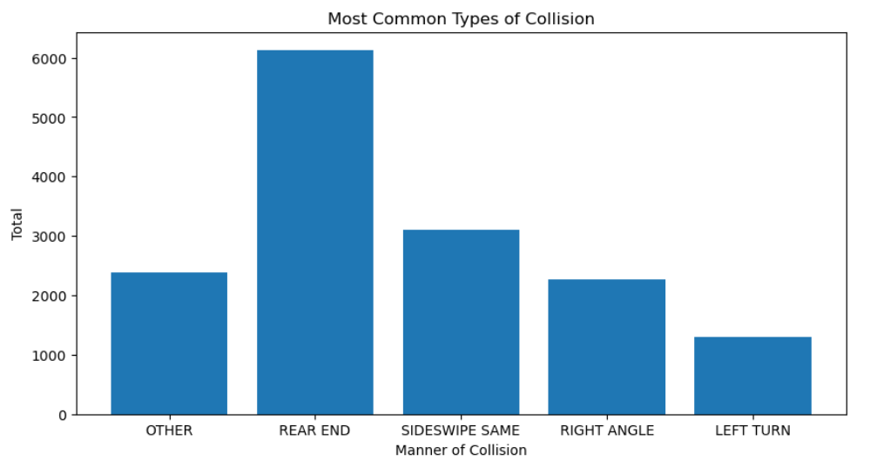
Results

Slide 5
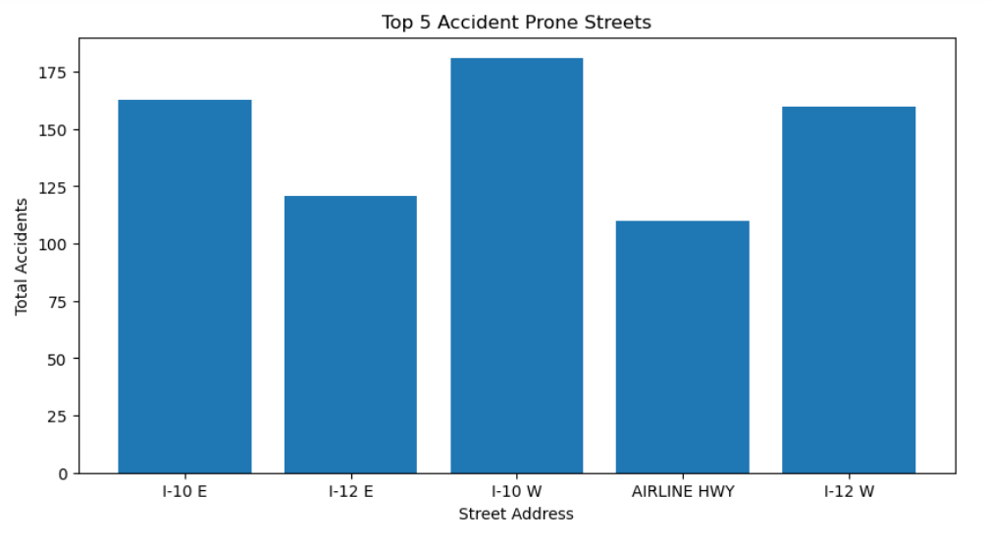

Slide 6
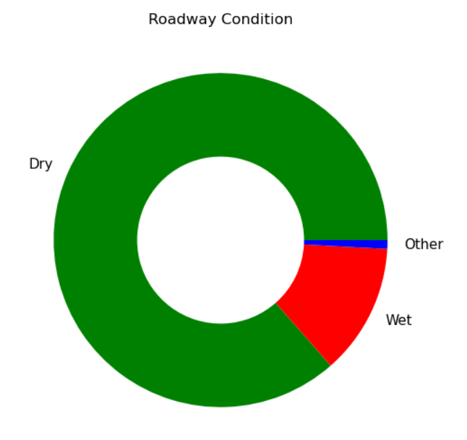
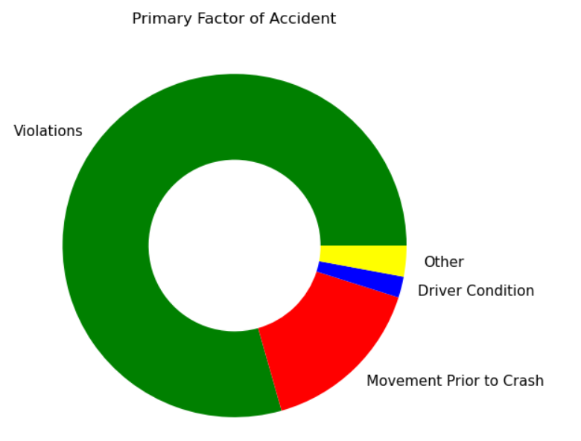

Slide 7
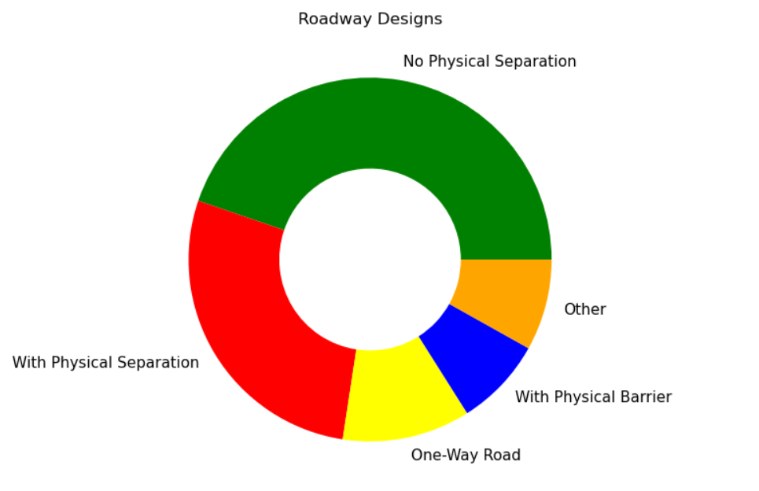

Slide 8
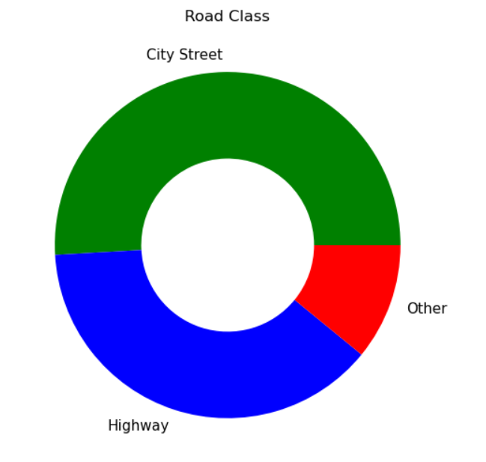

Slide 9
Conclusion
The data did answer some of my questions but they were not as monumental as I thought they may be.
There were no clear patterns or one single answer to determine the fix for these accidents
Since the most accidents happen on a road with no physical separation, the city could put up some sort of barrier in between lanes
51% of accidents occurred on city streets

Slide 10
Future Work
Explore a map visualization tool and the geolocation from the data set to give a better graph of the highway/ street system of Baton Rouge. Like the covid map on the new york times
Other statistics to base questions off of
37% of accidents happened at intersections
25% of accidents are hit and runs
27% of accidents happened at night

